Slide 1


Slide 2


KIET Group of Institutions
Department of Computer Applications
Project:
Privlok (Password Keeper)

Slide 3


Privlok (Password Keeper)
MENTOR:
Team Members:
Nirmit Bansal
Archana Varshney (Leader)
Himanshu Sharma
Sachin Rathi
Dr. Vipin Kumar Sir

Slide 4

Privlok ( Privacy + Locker)
A Password keeper Android App that securely manage your Password

Slide 5




Slide 6

PRIVACY
Totally FREE
Easy to use
Better Security
All data stored in a structure manner.

Slide 7

It stores all your passwords, login information and important records safely in one secure location that is protected with a password of your choice.
Save all sensitive data in a STRUCTURE manner.
User remember their passwords all time.
No warry about loosing their data .

Slide 8
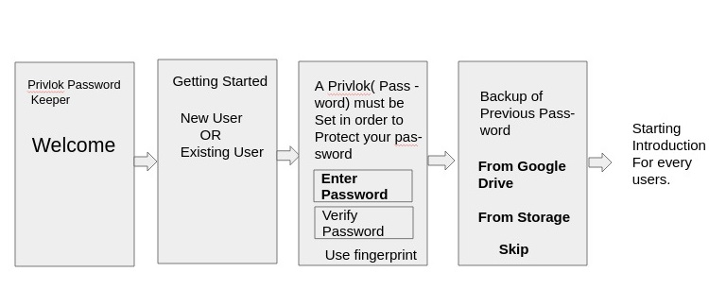
Flow Chart
(Introduction Interface)

Slide 9

Project Working

Slide 10
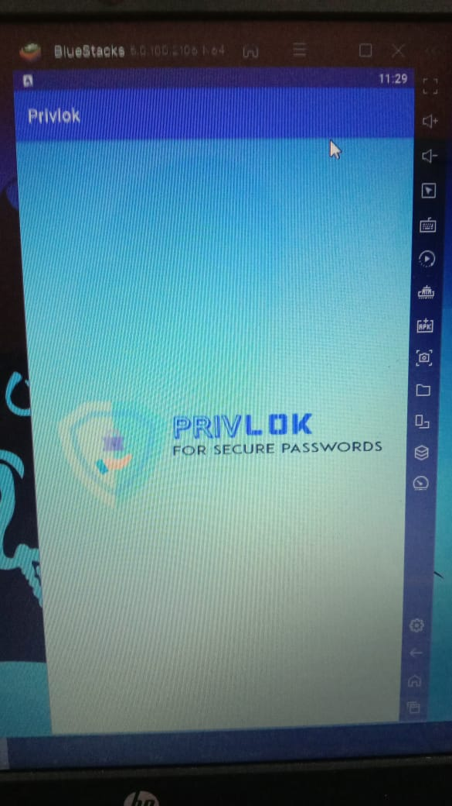

Slide 11
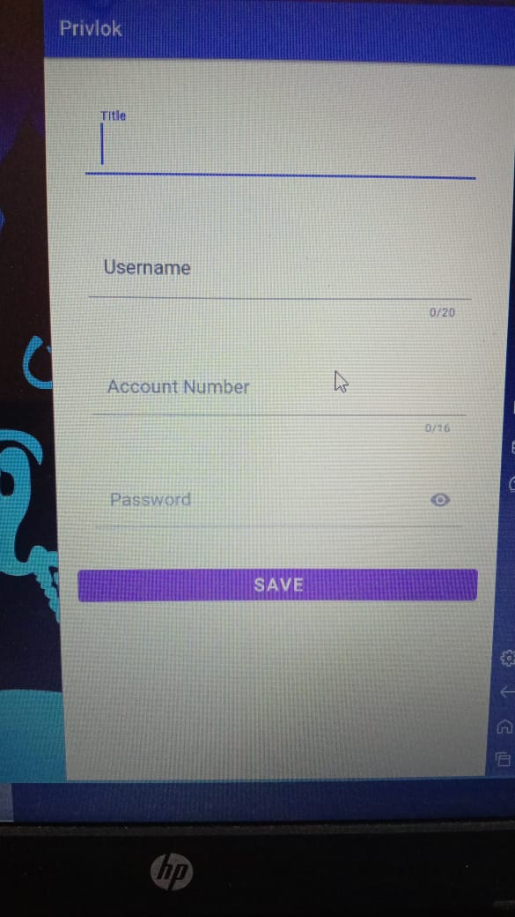

Slide 12
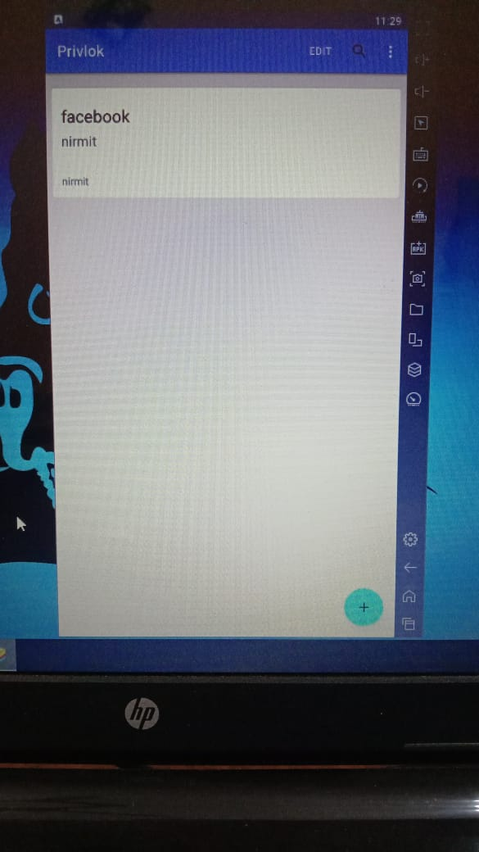

Slide 13
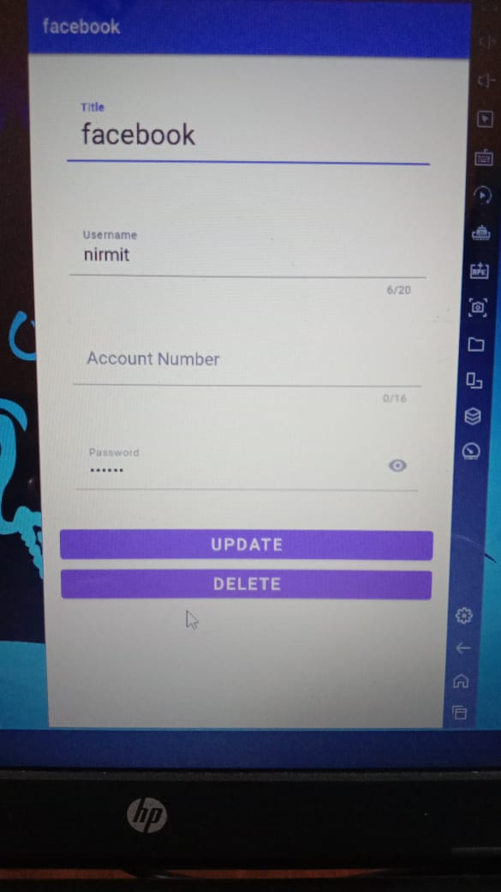

Slide 14
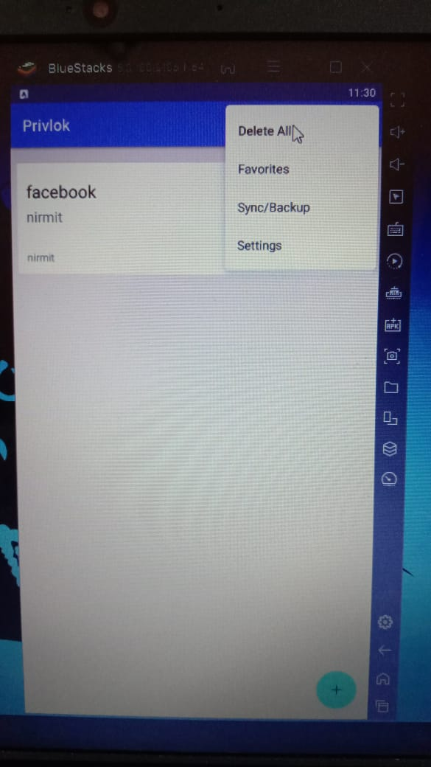

Slide 15
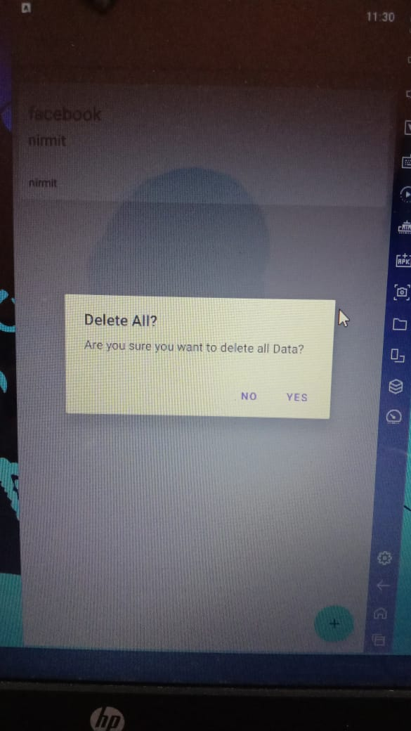

Slide 16

THANK YOU

Slide 17

FEEDBACK

